Slide 1
JDS-3
Java Design Studio - 3
Instructor
Ryan Liu
dio.ryanliu@Hotmail.com

Slide 2
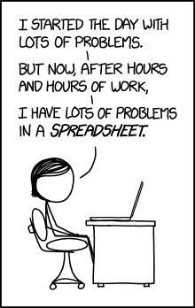
Homework
Homework for next class
Project Progress
Notes:
5 problems of difficulty “easy” from https://leetcode.com/problemset/all/
Ask about project progress
Check if they have achieved their goals and if they have not, ask them why not
4 people in 30 minutes -> 7.5 minutes each

Slide 3
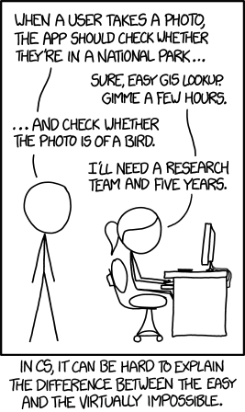
Task Boards
What is a Task Board?
Why do we use it?
Examples?
Notes:
What are some of the reasons why you would use a task board?
Really good to separate your tasks so you can focus on doing 1 thing at a time.
Understand priority and complete what you need to do
Sense of accomplishment
Visualize work

Slide 4
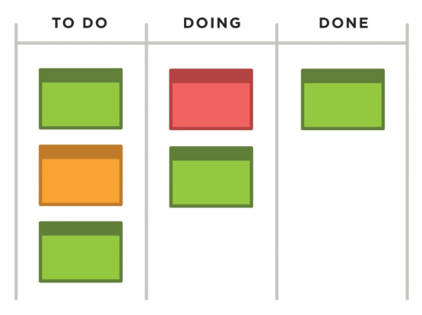
Example
Notes:
Here is an example of a task board

Slide 5
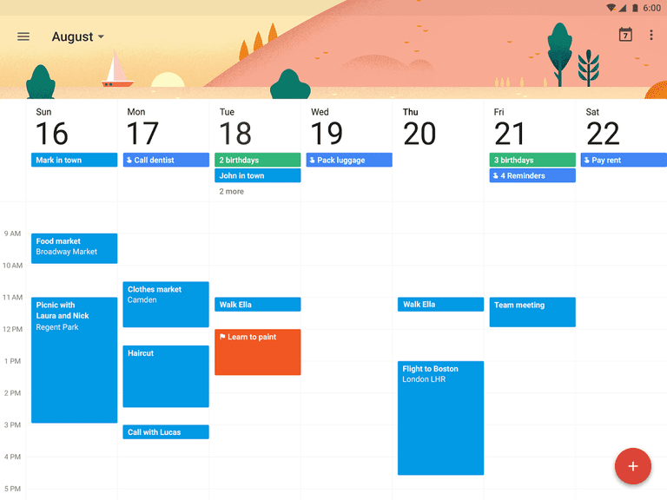
Example
Notes:
Here is an example of a task board

Slide 6
Trello
Separate project into smaller components
Critical to project management
Usage is warranted for companies, less for individual projects
Focuses on Agile Development – divide work among developers

Slide 7
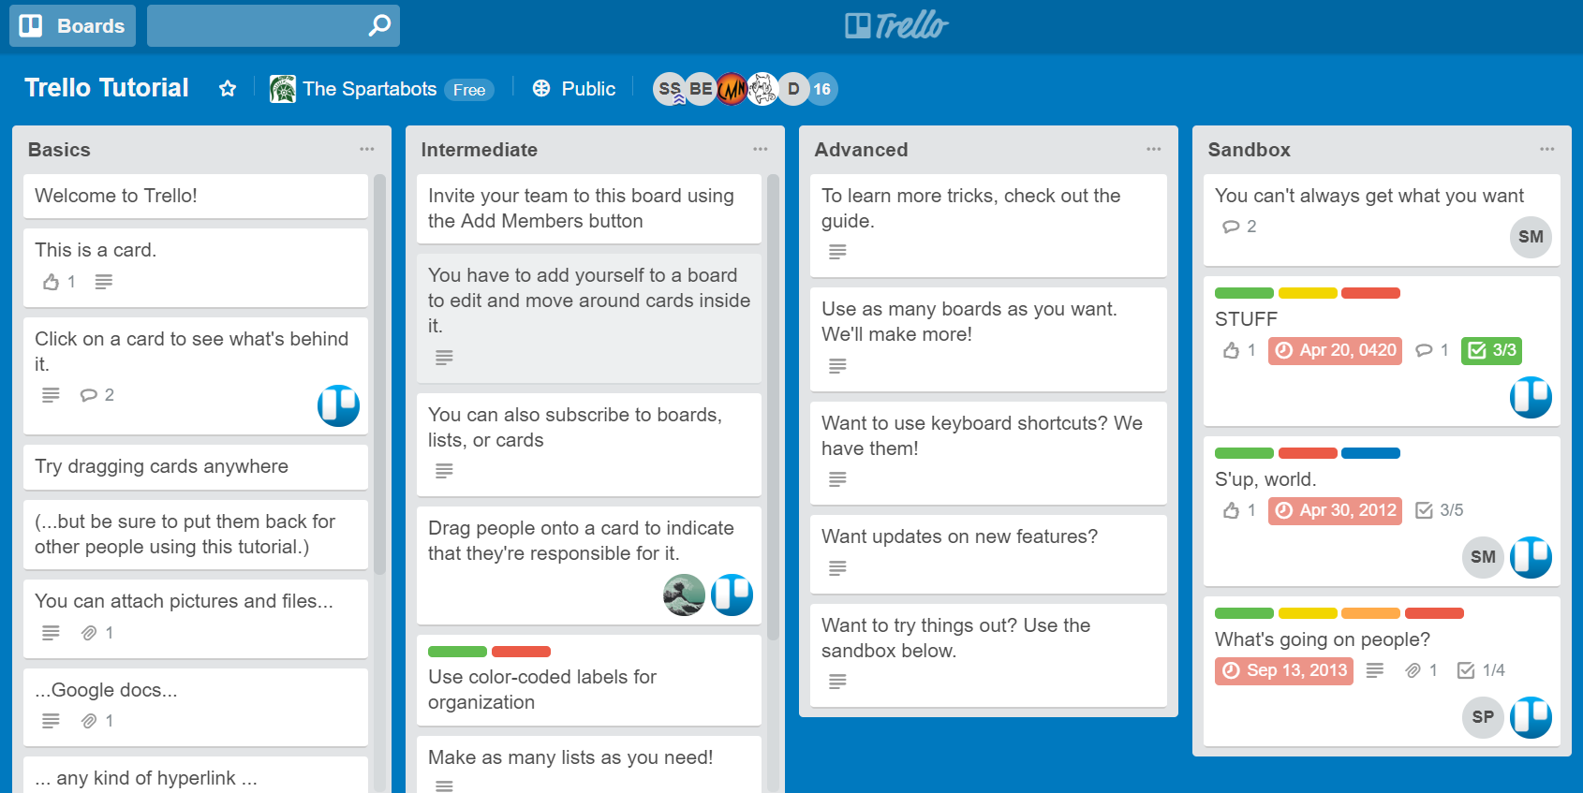
Notes:
Show SMART Trello board
https://trello.com/b/LkVGMKB2/smart-winter-2017-intern-project

Slide 8
More Homework
Trello Tutorial
Use Trello for this project
Create tasks to divide up work
Progress is necessary
Notes:
https://trello.com/b/I7TjiplA/trello-tutorial
I want to be able to see your progression to see that you are doing work
If you’re not doing work maybe something needs to change

